Slide 1
Project 2 Ames House Price Prediction

Slide 2
Objective: Tasked with creating a regression model based on the Ames Housing Dataset. This model will predict the price of a house at sale.

Slide 3
Problem Statement
1. Main issue we are facing is the vast amount of data columns
2. Model can only contain at most 30 columns, this includes get dummies feature columns
3. How do we data clean?
4. How we do select the data columns?

Slide 4
Beginnings
Look through data to notice odd patterns
Some may have almost all rows of the same value, so can consider dropping
Decision on how to fill null values
Think about what data type each column should be
If any columns dropped at beginning is it done for both train and test

Slide 5
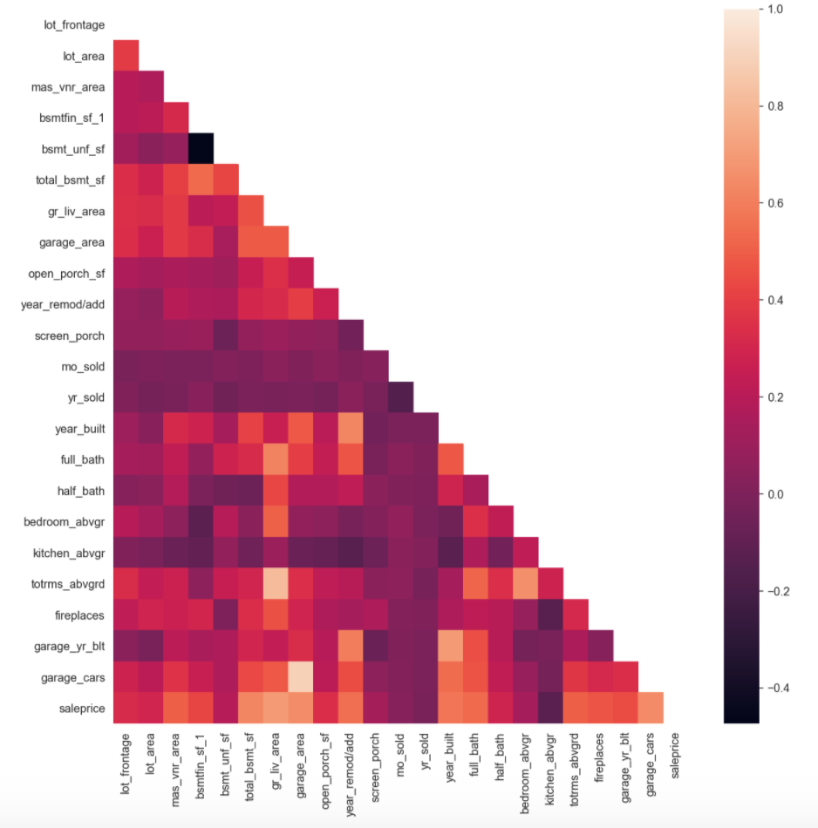
EDA
Numerical
Check correlation with sale price
Check potential columns for collinearity
Use correlation table and visuals to aid your analyzing process
Such as heatmaps and scatterplots

Slide 6
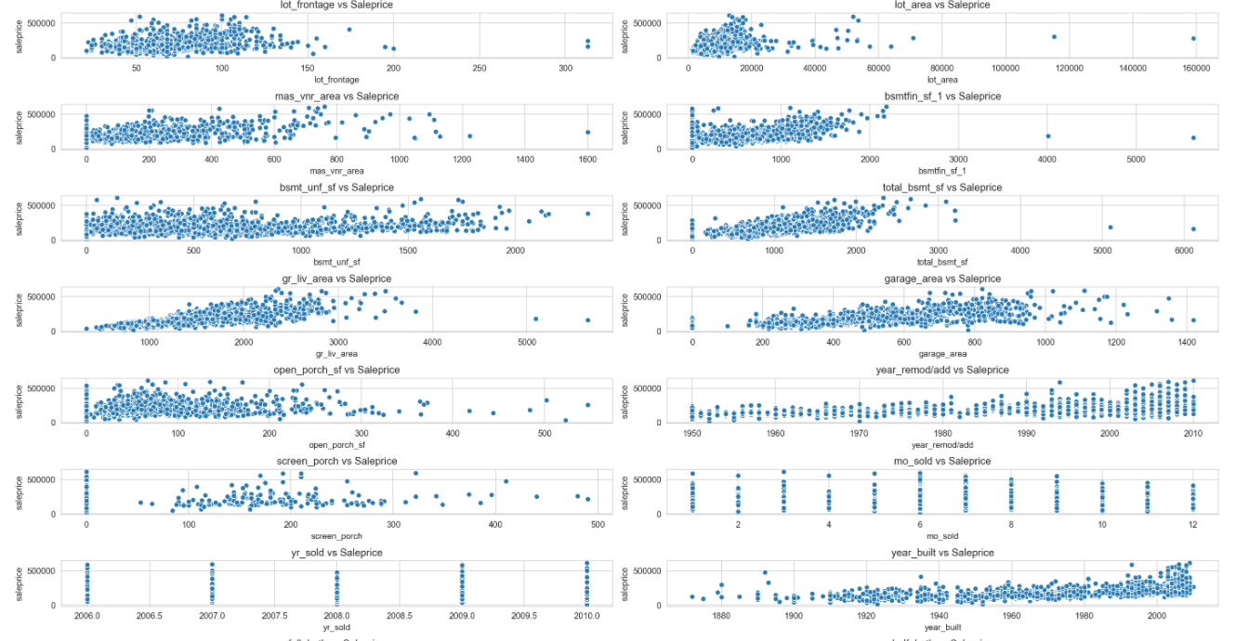
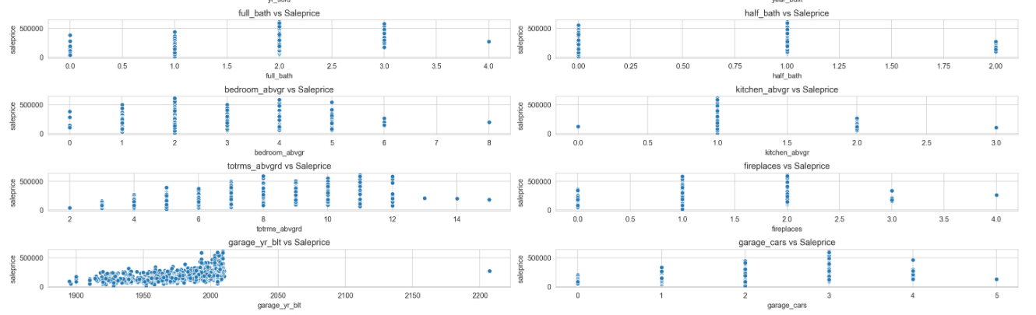
EDA
Scatterplots help to see the relationship and any possible correlation trends

Slide 7
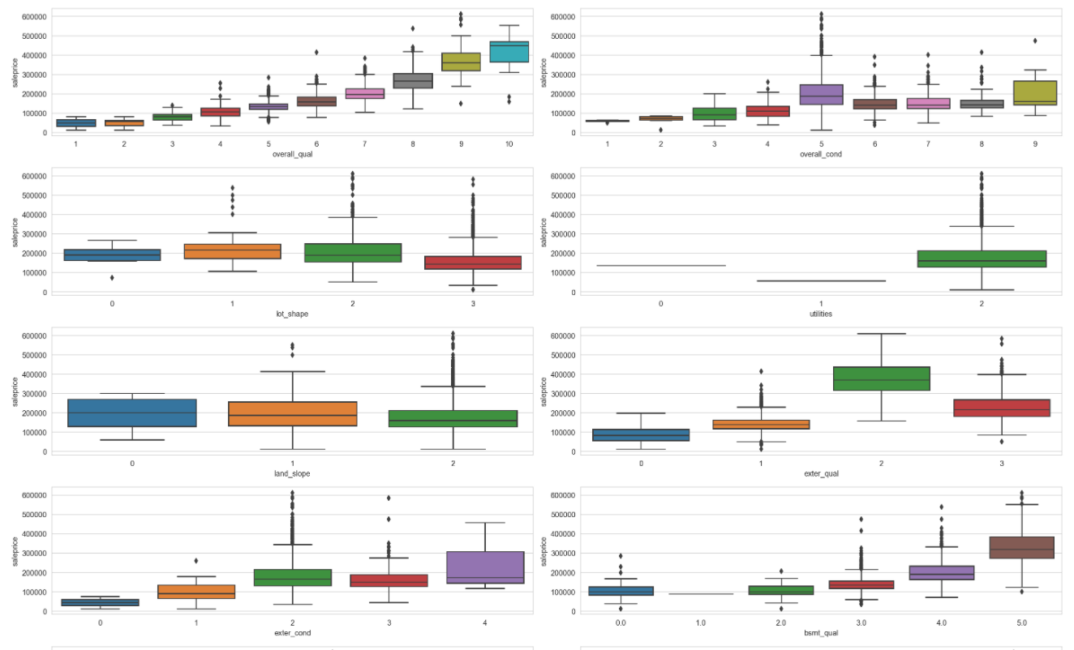
EDA
Notice rank 5 median sale price is higher than rank 9?
Ordinal
Ordinal data consist of rankings
Can use boxplots to analyze
Look at the pattern of boxplots and median sale price

Slide 8
EDA
Nominal data
Can use boxplots and also decide which column sound plausible

Slide 9
Feature engineering
Try to see which columns can interact with each other
For example, fireplace and fireplace quality might be possible to interact
Age of house could be difference of year sold and year built
Ordinal data will need to be mapped to numbers
Do get dummies on nominal data

Slide 10
Modeling
Ran GridsearchCV for finding best parameters for linear regression, ridge and lasso
Lasso score on train data is 0.79
Lasso score on test data (unforseen data) is 0.85
Lasso is good for this situation because it can bring down coefficients of features to 0
27 features remain, satisfying feature quota

Slide 11

Thanks!
Geoffrey Liu

